Slide 1
BH-PCMLAI: University of California, Berkeley Module 24: Capstone Project Presentation BGP Routing Anomaly Detection System
Shaji Ravindra Nathan
Section B
11/26/2022

Slide 2
INDEX
Technical Landscape
Problem Statement
Proposed Solution
Methodology & Application
Results Summary
Next Steps

Slide 3
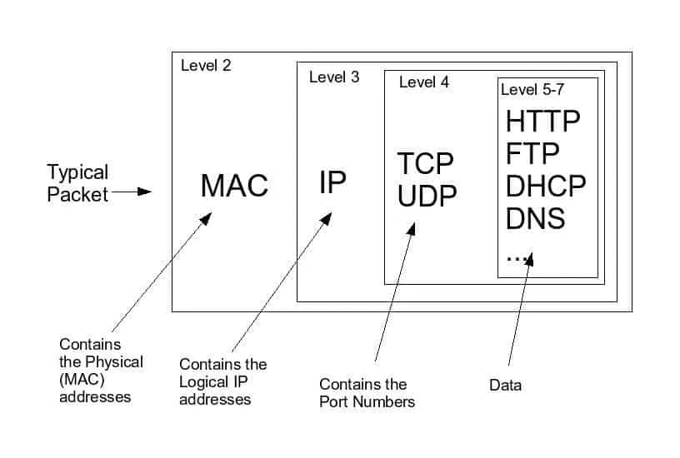
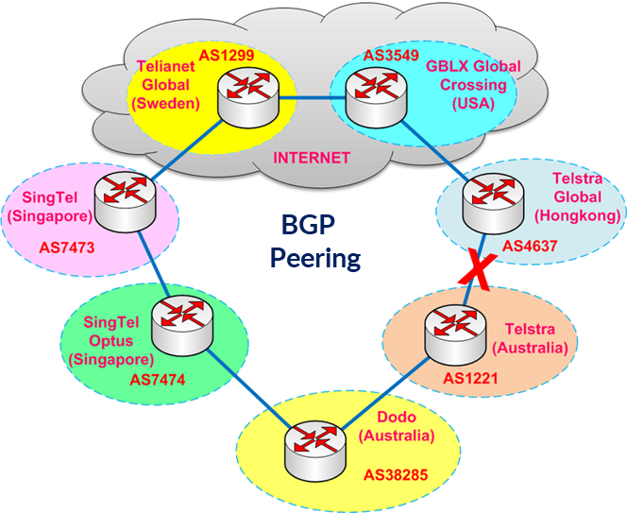
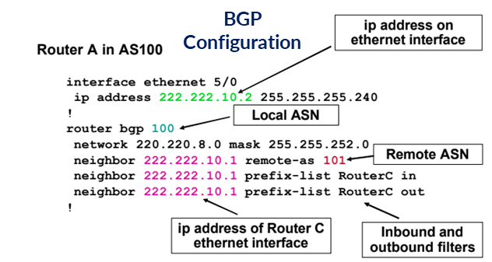
BGP Routing Explained
Border Gateway Protocol — the “post office of the internet”
Responsible for sending information in the form of “packets.”
In simple terms, internet traffic consists in hundreds of millions of routers and switches communicating with another using digital signals.
These signals are arranged in packets, which are sequences of 1s and 0s of a designated length.
Border Gateway Protocol Core Functions:
Enabling coordination between the over 70,000 different networks that interconnect into the single global communication infrastructure that we call the internet.
Standardized way to exchange routing and reachability information among networks which make up the internet a.k.a autonomous systems (AS) on the Internet. For example: ATT has an ASN # 7018
Make routing decisions based on network paths, network policies, or rule-sets configured by a network administrator.
Guide Internet Protocol packets from end user to the final destination across the internet

Slide 4
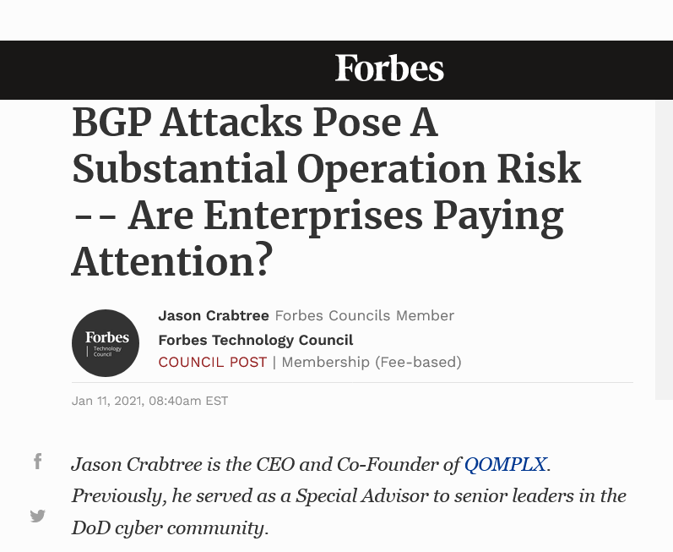
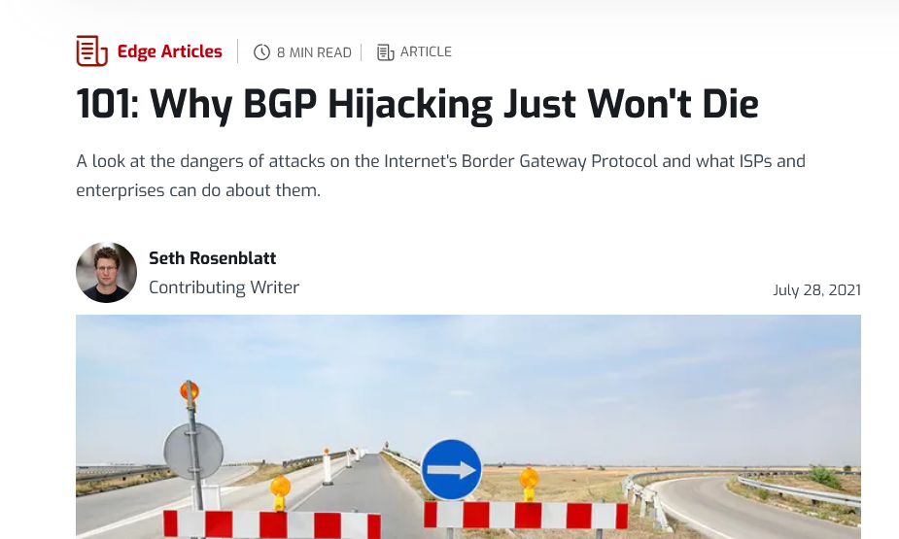
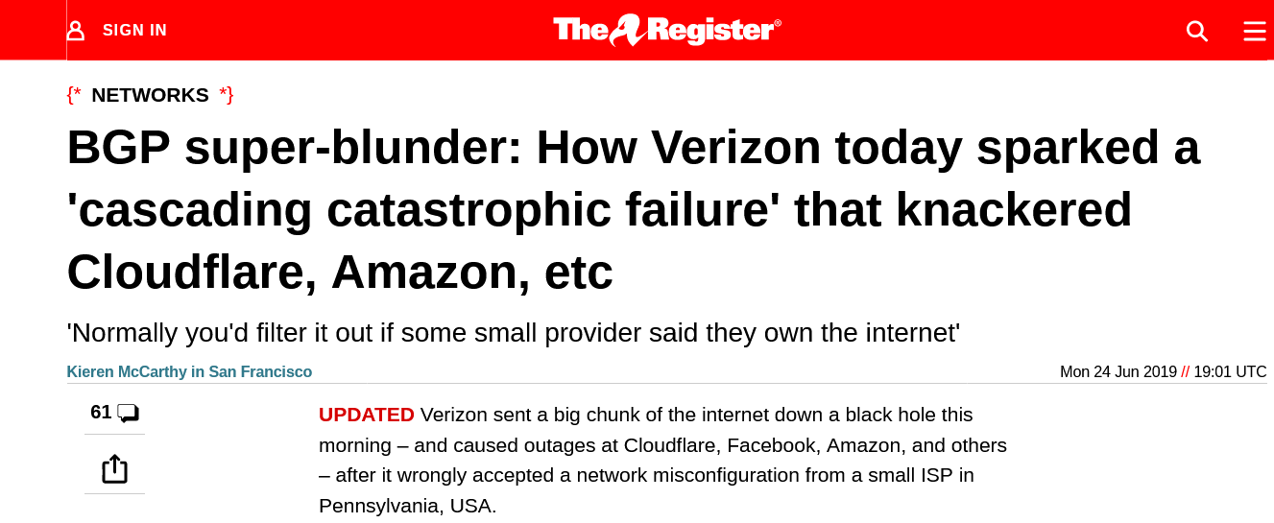
Problem Statement: BGP related Malicious Activity in the news
Financial Impact Example:
On Monday, October 4 2021, a BGP outage cost Facebook roughly $60 million in revenues over its more than six-hour period.
Facebook shares fell 4.9 percent on the day, which translated into more than $47 billion in lost market cap.
Reference: https://www.datacenterdynamics.com/en/opinions/too-big-to-fail-facebooks-global-outage/
Live Outage Map: This map shows outages at any given time on the internet
https://www.thousandeyes.com/outages/?utm_source=Blog&utm_medium=Textlink&utm_campaign=Most-Disruptive-Internet-Outages-2020

Slide 5
Too much data and no time
Internet traffic data is logged, however, the scale is far too great to actively monitor and react:
Projected Global 5G Subscriptions and Data Traffic Forecasts
100Gbps allows a single pathway to present one valid 64 octet IP packet every 5 nanoseconds
It is a near impossibility to inspect the veracity of all of it without introducing unacceptable latency
As internet usage proliferates around the globe, the vulnerabilities will only increase
5G Subscriptions (millions)
5G Traffic (EB/Month)
So how do we distinguish malicious activity from legitimate usage?
Notes:
It should surprise no one that internet traffic is logged. However, the data is in the Exabytes and the activity is happening at effectively the speed of light,
placing it beyond all hope of tracking and managing in real time.
Key Stats: Globally, consumer Internet traffic reached 292.8 EB per month in 2022, the equivalent of 73 billion DVDs per month, or 100 million DVDs per hour.
Globally, consumer mobile data traffic was 9.4 EB per month in 2017, the equivalent of 2 billion DVDs per
month, or 3 million DVDs per hour. Reached 66.4 EB per month in 2022, the equivalent of 17 billion DVDs per month, or 23 million DVDs per hour.
Reference URL:
https://www.cisco.com/c/dam/m/en_us/solutions/service-provider/vni-forecast-highlights/pdf/Global_Device_Growth_Traffic_Profiles.pdf
Furthermore, what constitutes bad behavior is not always obvious.
Mobility is now a part of our lives and the network is almost anywhere. There are no finite boundaries.

Slide 6
Machine Learning Based Solution: BGP Anomaly Detector for Routing Security

Slide 7
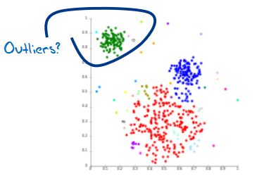
Machine Learning (ML) for Anomaly Detection
What it does :
Detects BGP routing security breaches, anomalies
How it is done:
Initial goal is to use a supervised machine learning model
That does Real time Classification of BGP Updates
Separates routing traffic into two classes
Normal
Anomalous Traffic
Labeled training samples used to learn a classification hyperplane
Machine Model developed from real time BGP updates
How it is deployed:
A standalone classification software package that works with ACLs and BGP module in OCNOS (Open Compute Network Operating System)
This software can be pushed to interact with OCNOS control plane via a docker container
Can be Sold as an upsell application on top of OCNOS

Slide 8
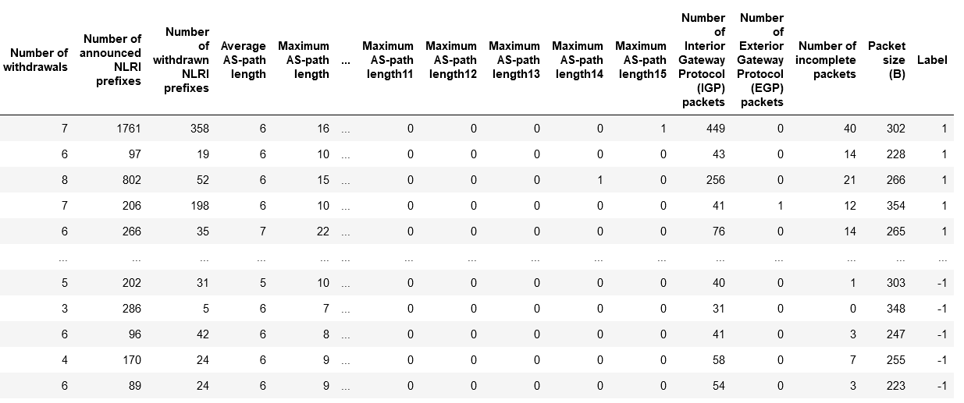
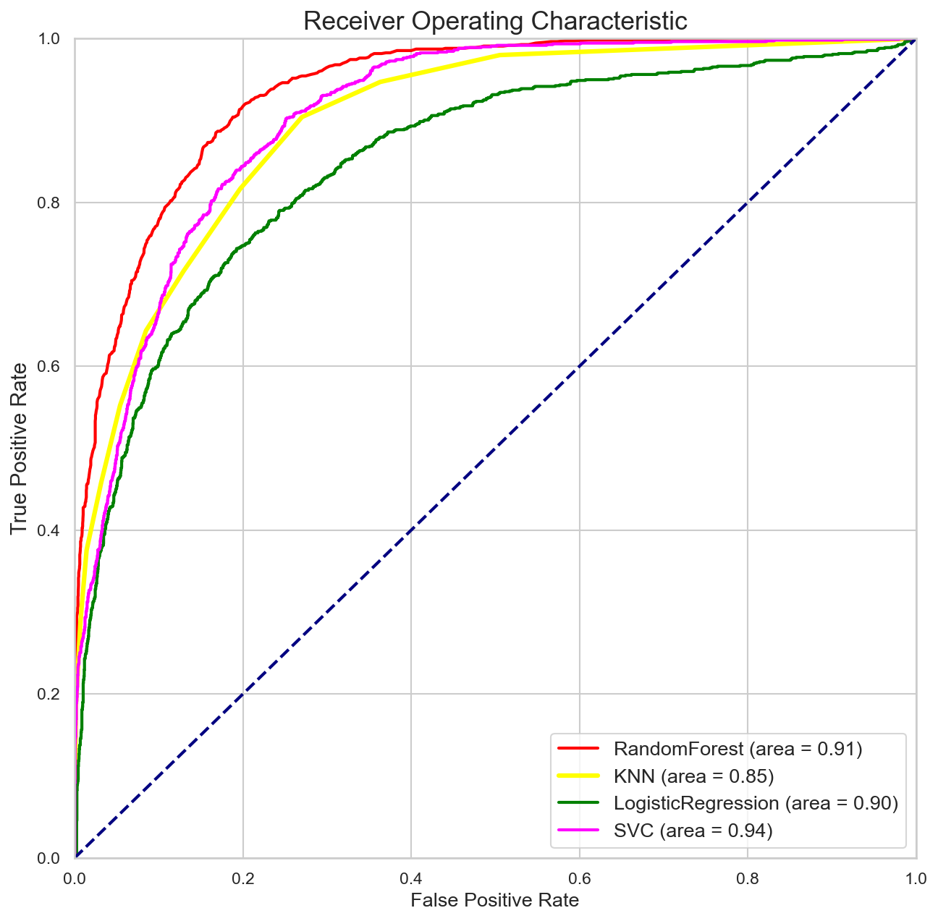
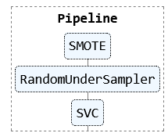
Methodology Used
A dataset with 42 features was labelled for Nimda, Codred and WannaCry
Multiple models were built using Supervised Learning
Logistic Regression
RandomForest
KNN
Support Vector Machine
SVM was selected as it had the best performance

Slide 9
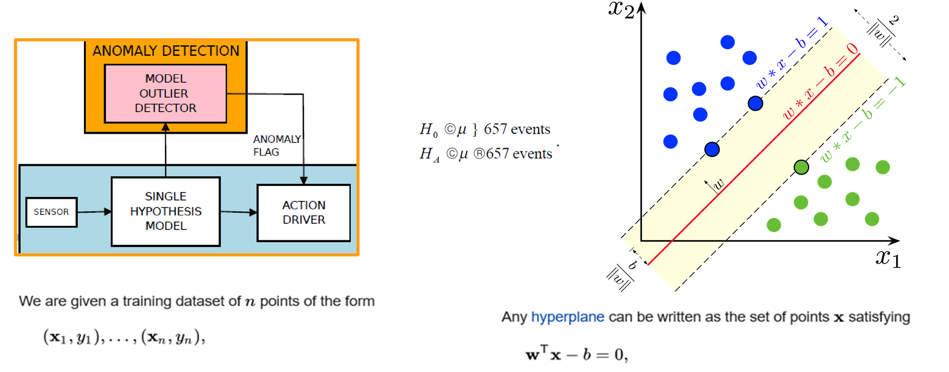
Support Vector Machine Explained
Anomaly Detector High Level Functional Blocks
The idea is to come up with a two class classifier that classifies BGP updates with
1 indicating an anomaly and -1 indicating normal update

Slide 10
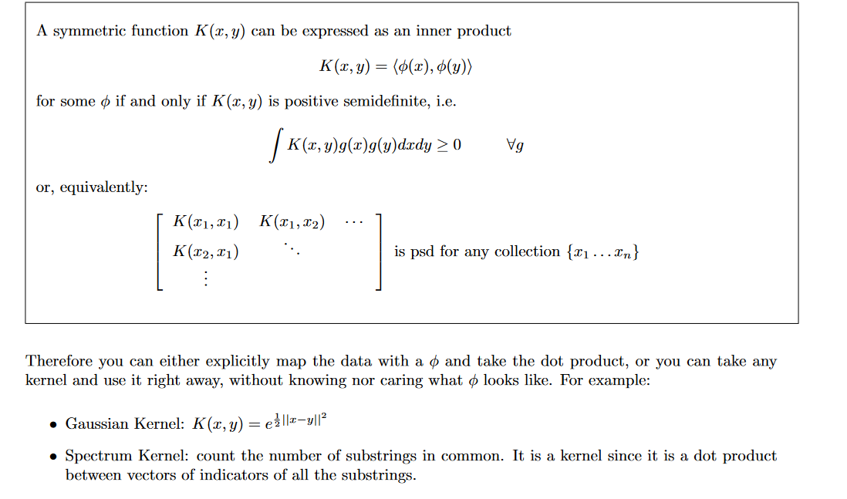
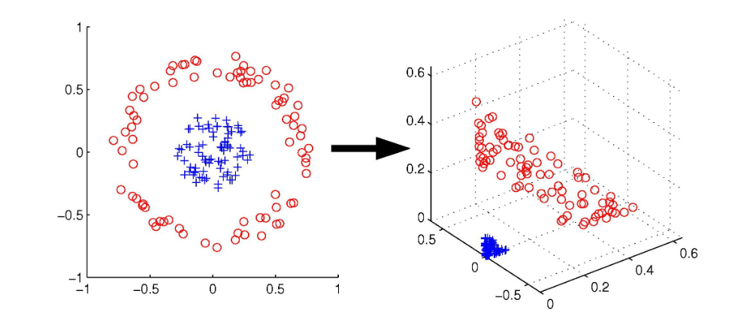
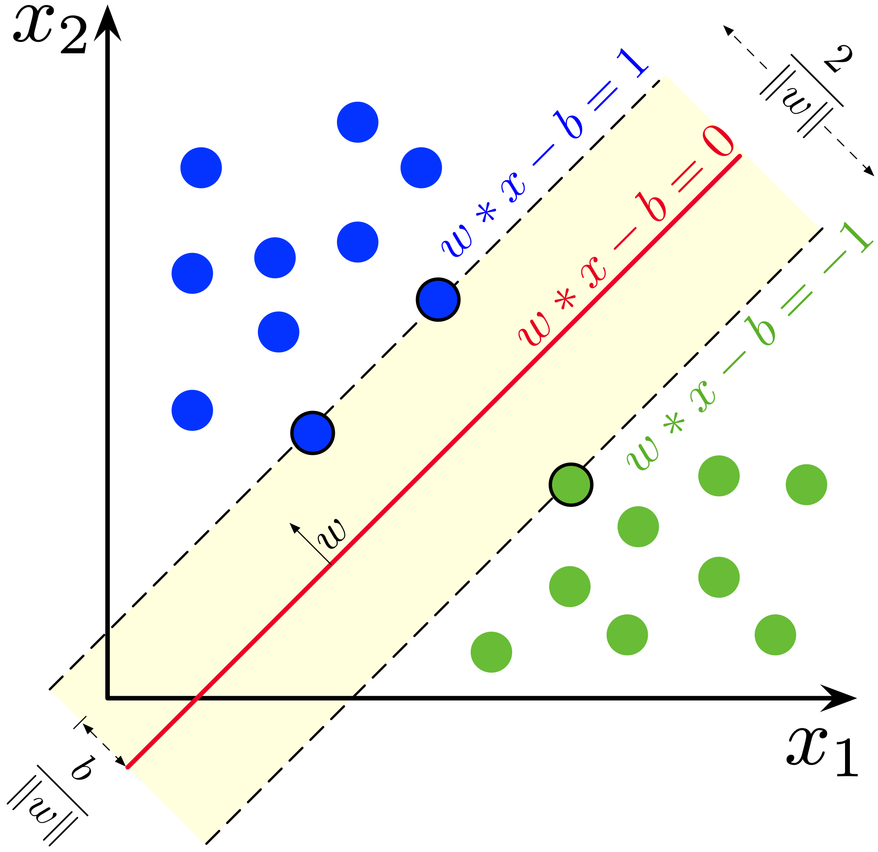
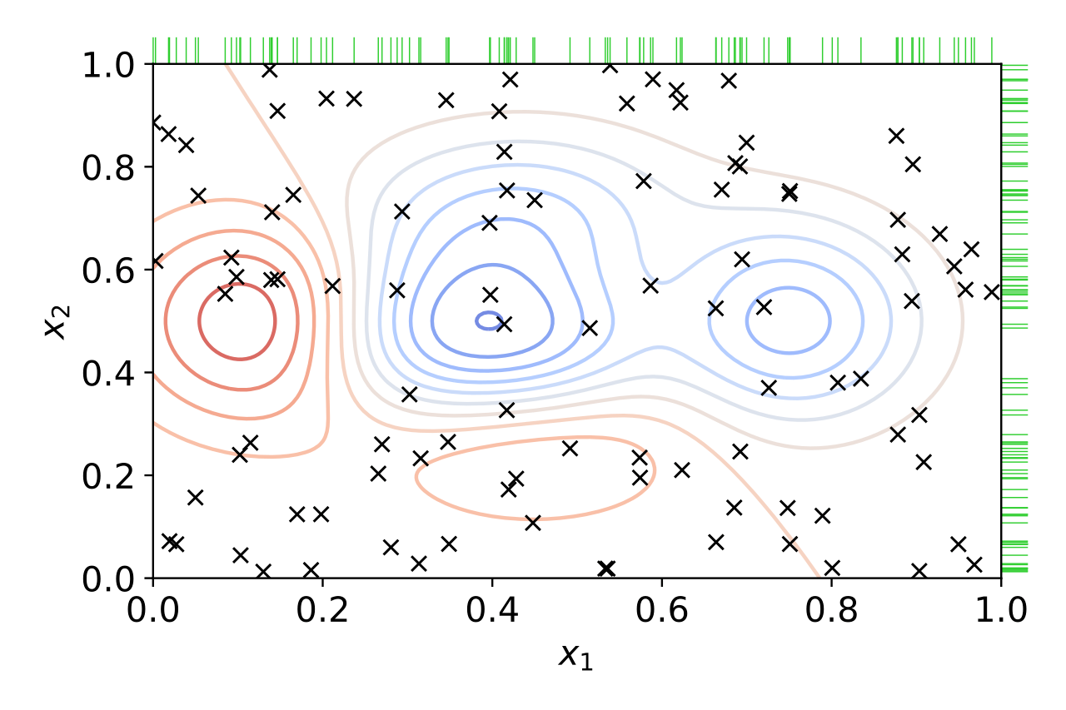
Support Vector Machine Explained
SVM Kernel Trick (Radial Basis function)
Transforming data to make it linearly separable

Slide 11
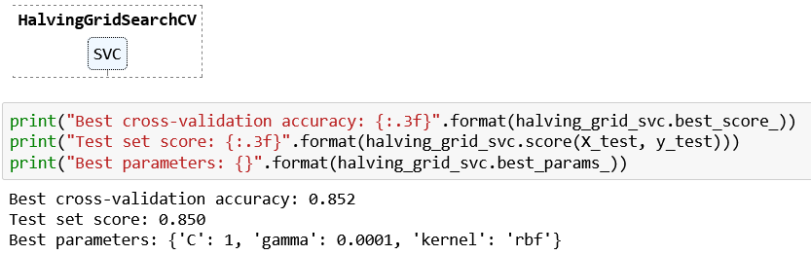
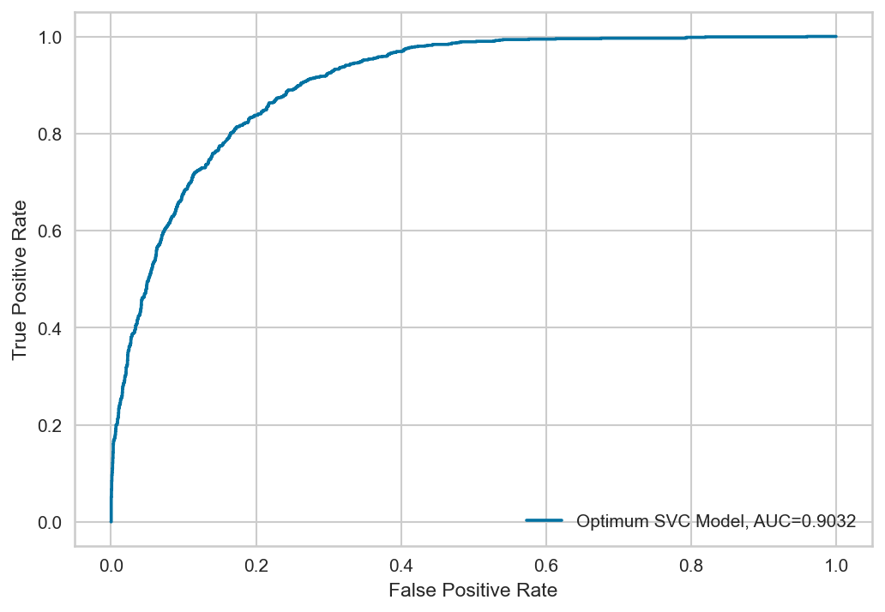
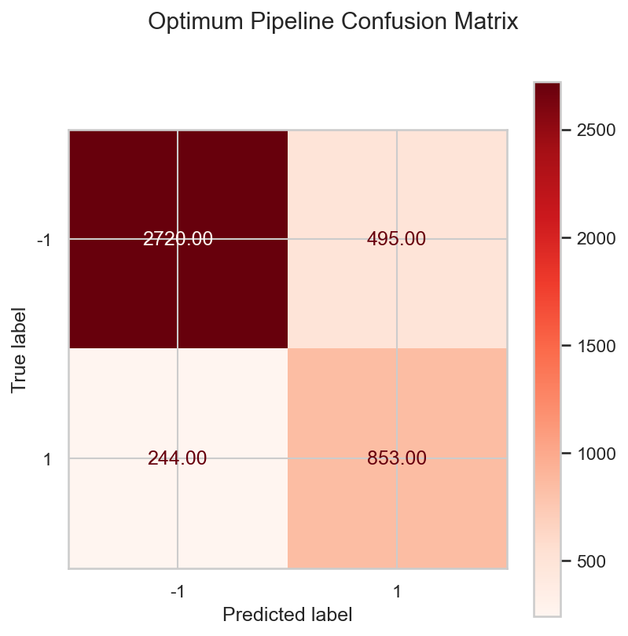
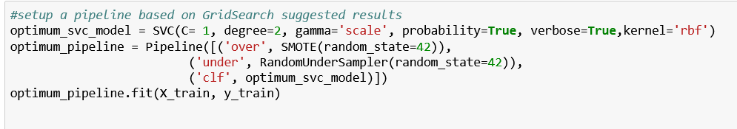
Methodology Used
GridSearch was used to do the best hyperparameter selection
SMOTE library was used to balance the classes
The parameters were used to build the final model
This new model was used for predicting new BGP updates

Slide 12
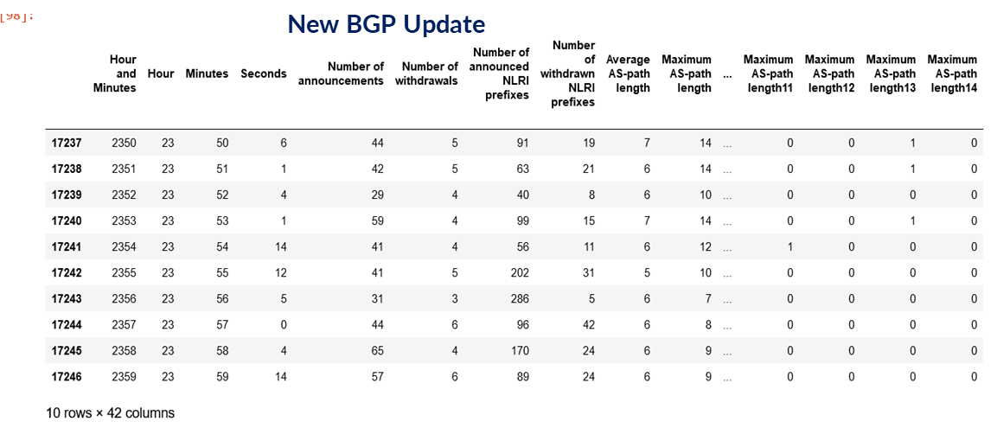
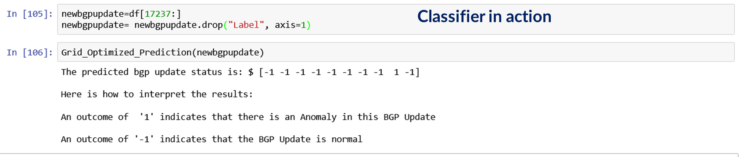
Result Summary
The resulting model is able to classify new BGP routing update traffic from a cellular gateway like so:
-1 for normal traffic
1 for anomalous traffic
Example below

Slide 13
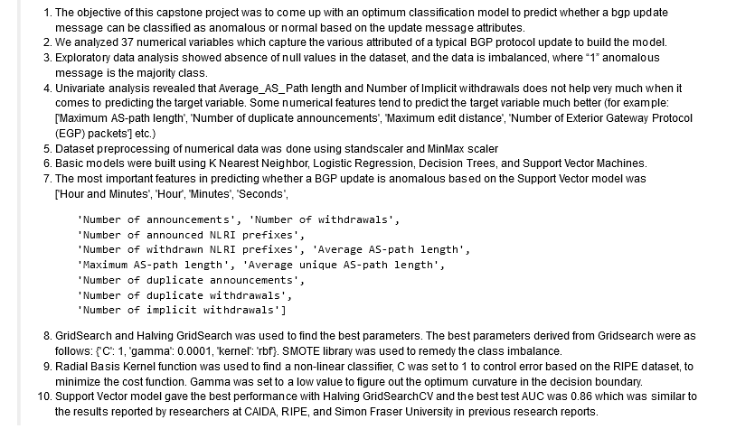
Results Summary: Actionable Insights

Slide 14
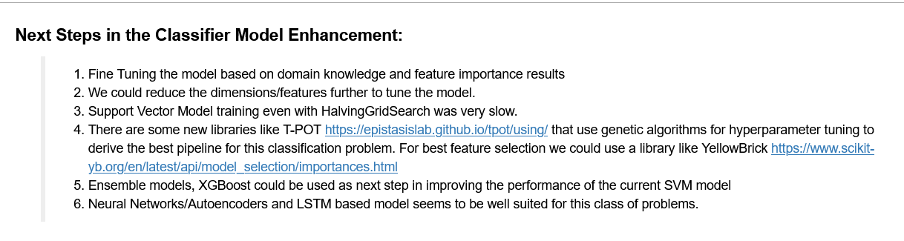
Next Steps

Slide 15
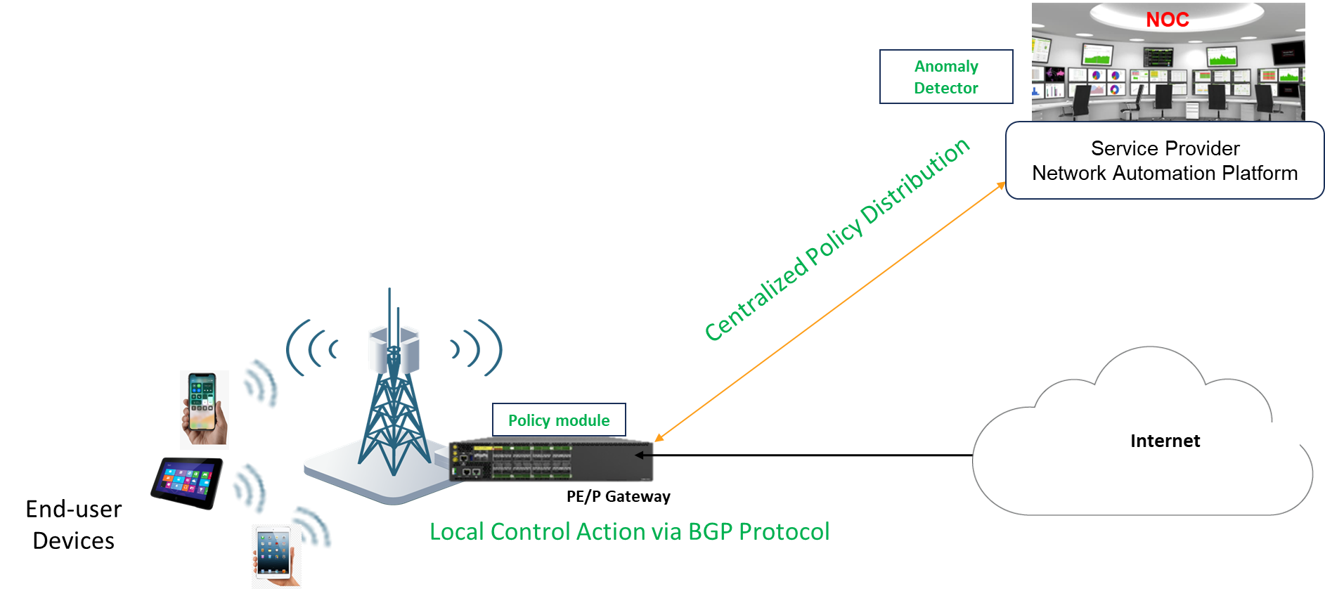
Network Deployment : Cellular Backhaul Gateway Protection
Anomaly Detector is deployed in the Cellular Data Center
BGP updates are provided to the AD pipeline by a BGP agent
BGP agent does the ETL on the packet header
Provides Realtime detection of BGP Anomalies/Malicious attacks
Cell Gateway autonomously blocks/reroutes anomalous traffic
Business Benefit:
Enables Telco Carriers to respond in real time to
Emerging Threats
Zero Day Attacks
Routing Anomalies
Prevents Loss of Service without Truck Roll
Lowers Security OPEX and CAPEX

Slide 16

The Business Benefit:
Future
Threat Profile
Persistent
Targeted
Evasive
Distributed
Advanced
Predict
Expected Behavior based on empirical monitoring & acquired knowledge
Analyze
Raw Packet Meta Data over a preset rolling window
Verify
Predictions to identify suspicious packets,traffic patterns relationships etc.
Adapt
Notify unacceptable behaviors
Adapt network policies dynamically
Finding a needle in a haystack
Current APT
Attack
Profile

Slide 17
Future Use Cases in Telecom using AI/ML Techniques
Current Project

Slide 18
Thanks ! contact: shaji.nathan@ipinfusion.com phone: 408.400.1503

